Slide 1
SimplyRhino, London
February 12-14,2020
Python Scripting for
Rhino/Grasshopper
Day 3
Long Nguyen
Thu Nguyen-Phuoc

Slide 2
DataTree

Slide 3
Example: Create a list of spheres from a tree of points
Please open file DataTree.gh
import Rhino.Geometry as rg
spheres = []
for points in iPointTree.Branches:
for point in points:
spheres.append(rg.Sphere(point, 2.0));
oSpheres = spheres;

Slide 4
Example: Create a TREE of spheres from a TREE of points
Please open file DataTree.gh
import Rhino.Geometry as rg
from Grasshopper import *
sphereTree = DataTree[rg.Sphere]()
for path in iPointTree.Paths:
points = iPointTree.Branch(path)
spheres = []
for point in points:
spheres.append(rg.Sphere(point, 2.0));
sphereTree.AddRange(spheres, path)
oSpheres = sphereTree;

Slide 5
Parallel Computation

Slide 6
Example: Intersecting MANY lines with a mesh
Please open the file Parallel Computation.gh
from Rhino.Geometry.Intersect import Intersection
import time
from ghpythonlib import parallel
def ProcessOneCurve(curve):
return Intersection.MeshPolyline(iMesh, curve.ToPolyline(0.1, 0.1, 0.1, 0.1))[0]
startTime = time.time()
intersectionLists = parallel.run(ProcessOneCurve, iCurves, False)
allIntersections = []
for intersectionList in intersectionLists:
allIntersections.extend(intersectionList)
endTime = time.time()
print endTime - startTime
oResult = allIntersections

Slide 7
Recursion
Recursive Functions
Fractals and L-Systems

Slide 8
What is recursion?
Recursion: Defining something using itself
An example (from Maths)
Factorial
Definition: n! = 1 * 2 * 3 * 4 * … * (n-1) * n
Alternative definition, using recursion:
1! = 1
and, n! = n * (n-1)!, where n > 1
Why it works?
10! = 10 * 9!
= 10 * 9 * 8!
= …
= 10 * 9 * 8 * … * 1!

Slide 9
Recursion in Programming
Recursive function: a function that call itself
Hands-on Example:
A recursive function that computes the factorial of a given number
Mathematical definition: 1! = 1
n! = n * (n-1)!, where n > 1
A recursive function
def Factorial(n):
if n == 1:
return 1
else:
return n * Factorial(n-1)
print(Factorial(4))

Slide 10
Recursive function: behind the scene
A recursive function
def Factorial(n):
if n == 1:
return 1
else:
return n * Factorial(n-1)
print(Factorial(4))
A recursive function must have at least one EXIT CODITION
When the code is execute:
Factorial(4) …
… will call Factorial(3),…
… which will call Factorial(2),…
… which will call Factorial(1),…
… which will return 1

Slide 11
Can we do it non-recursively?
A non-recursive factorial function
def Factorial(n):
result = 1
for i in range(2, n + 1):
result *= i
return result
In fact, any recursive algorithm can be converted to non-recursive form
But in many cases, recursive form is:
Easier to write
Easier to understand (and debug)
More elegant/succinct
More closely follow the original definition (e.g. from maths, fractals)
But, if not used carefully, they may also consume a lot of memory and computation time

Slide 12
Live Example: Creating Rhino geometry recursively
Step 1: Recursively create (continuous) line segments
import rhinoscriptsyntax as rs
def MoveRecursively(startPoint, moveVector, currentStep, maxStep):
endPoint = rs.VectorAdd(startPoint, moveVector)
rs.AddLine(startPoint, endPoint)
rs.AddPoint(startPoint)
if (currentStep < maxStep):
MoveRecursively(endPoint, moveVector, currentStep + 1, maxStep)
MoveRecursively( (0, 0, 0), (0.2, 0.6, 0), 0, 100 )

Slide 13
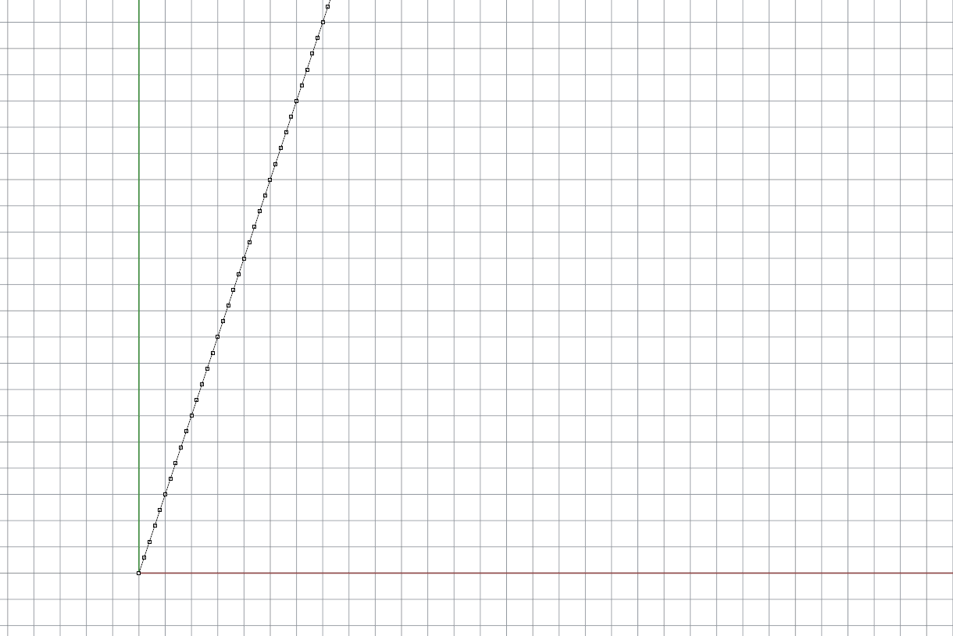
Live Example: Creating Rhino geometry recursively
Step 1: Recursively create (continuous) line segments

Slide 14
Live Example: Creating Rhino geometry recursively
Step 2: Slightly change the moveVector by a random amount at each step
import rhinoscriptsyntax as rs
import random
def MoveRecursively(startPoint, moveVector, currentStep, maxStep):
endPoint = rs.VectorAdd(startPoint, moveVector)
rs.AddLine(startPoint, endPoint)
rs.AddPoint(startPoint)
if (currentStep < maxStep):
moveVector = rs.VectorRotate(moveVector, random.uniform(-30, 30), (0, 0, 1))
MoveRecursively(endPoint, moveVector, currentStep + 1, maxStep)
MoveRecursively( (0, 0, 0), (0.2, 0.6, 0), 0, 100 )

Slide 15
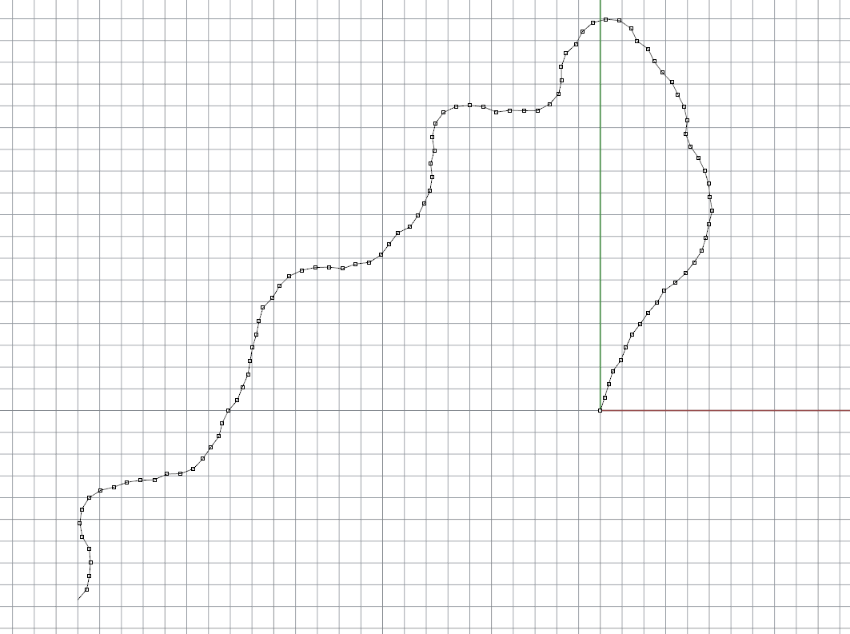
Live Example: Creating Rhino geometry recursively
Step 2: Slightly change the moveVector by a random amount at each step

Slide 16
A typical pattern for writing recursive function
def MyRecursiveFunction(inputData)
# Do something useful with inputData (e.g. draw geometries)
...
# compute the input data for the next/recursive call
nextInputData = ...
# Make the recursive call
MyRecursiveFunction(nextInputData)
# extra computation, if there is any
...

Slide 17
Recursion with branching

Slide 18
Branching recursion
A function can call itself more than once
The Fibonaci number sequence: 0 1 1 2 3 5 8 13 21 …
Recursive Fibonaci function
def Fib(n):
if n == 0:
return 0
elif n == 1:
return 1
else:
return Fib(n-1) + Fib(n-2)
print(Fib(4))
Fib(5)
Fib(4)
Fib(3)
Fib(3)
Fib(2)
Fib(2)
Fib(1)
Fib(2)
Fib(1)
Fib(1)
Fib(0)
Fib(1)
Fib(0)
Fib(1)
Fib(0)
Computation time is proportional to 2^{n}

Slide 19
Branching recursion
Watchout for exponential growth !!!
Computing the 52th term in the sequence will require 2⁵⁰ recursive calls to the Fib function
Even if each call takes only 1 nanosecond to compute, the total time will be 13 days
Similarly the 66th term will take almost 300 years
… and the 99th term will take 19 billion years !!!

Slide 20
A non-recursive version
Non-Recursive Fibonaci function
def Fib(n):
if n == 0:
return 0
elif n == 1:
return 1
else:
previous = 0
current = 1
for i in range(1, n):
next = current + previous
previous = current
current = next
return current
Computation time is proportional to n

Slide 21
Fractal Geometries

Slide 22
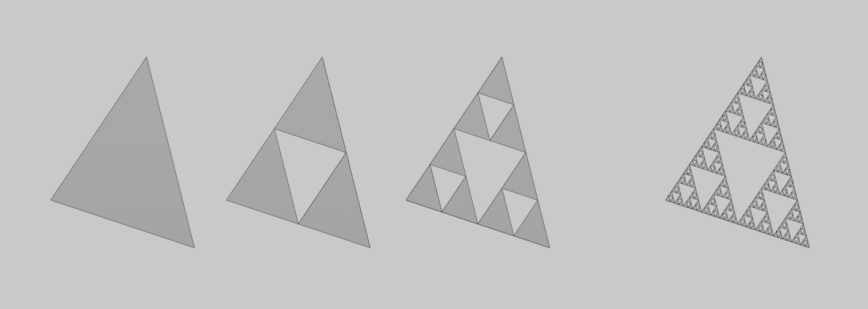
Live Example: Sierpenski triangle
…
Level 0
Level 1
Level 2
Level 5

Slide 23
Live Example: Sierpenski triangle
import Rhino.Geometry as rg
mesh = rg.Mesh()
def SubdivideTriangle(A, B, C, levelRemained):
if levelRemained == 0:
mesh.Vertices.Add(A)
mesh.Vertices.Add(B)
mesh.Vertices.Add(C)
f = mesh.Vertices.Count
mesh.Faces.AddFace(f-3, f-2, f-1)
else:
M = 0.5 * (A + B)
N = 0.5 * (B + C)
Q = 0.5 * (C + A)
SubdivideTriangle(A, M, Q, levelRemained - 1)
SubdivideTriangle(M, B, N, levelRemained - 1)
SubdivideTriangle(Q, N, C, levelRemained - 1)
SubdivideTriangle(rg.Point3d(2,4,0), rg.Point3d(0,1,0),
rg.Point3d(3,0,0), 5 )
A
M
Q
B
N
C

Slide 24
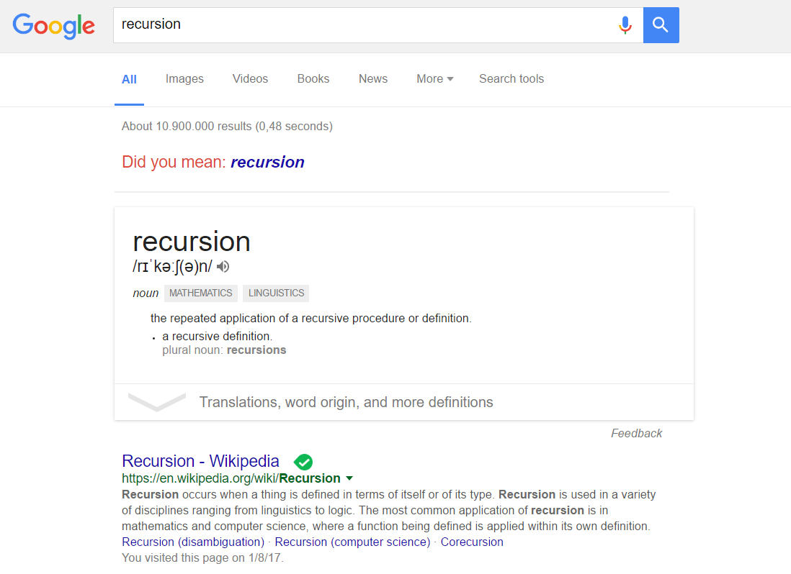
A recursive joke from Google

Slide 25
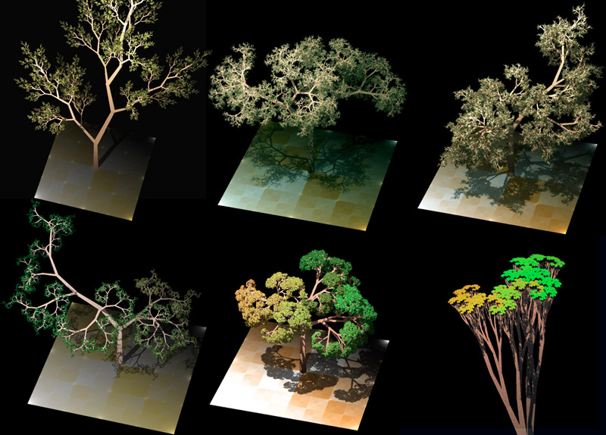
Live Example: Tree growth
L-System invented by Lindenmayer (1968)
A formal way to describe the growth of tree
Based on the so-called “parallel rewriting system”: essentially a set of recursive rules, optionally with adjustable parameters and some randomness
Can realistically generate the shape (morphology) of many trees/plants

Slide 26
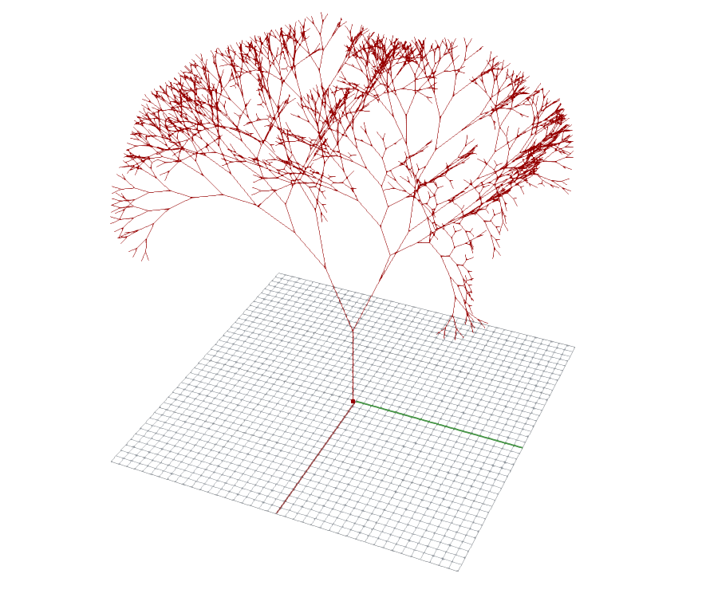
Live Example: Tree growth
Step 1: Defining a branching recursive function

Slide 27
Live Example: Tree growth
Step 1: Defining a branching recursive function
import Rhino.Geometry as rg
branches = []
def Branch(startPos, dir, levelRemained):
endPos = startPos + dir
branches.append(rg.Line(startPos, endPos))
if (levelRemained > 0):
normalPlane = rg.Plane(endPos, dir)
leftBranchDir = rg.Vector3d(dir)
leftBranchDir.Rotate(-iSpreadAngle, normalPlane.XAxis)
leftBranchDir *= iShrink
Branch(endPos, leftBranchDir, levelRemained - 1)
rightBranchDir = rg.Vector3d(dir)
rightBranchDir.Rotate(iSpreadAngle, normalPlane.XAxis)
rightBranchDir *= iShrink
Branch(endPos, rightBranchDir, levelRemained - 1)
Branch(iRootPosition, iRootDirection, 10)
leftBranchDir
rightBranchDir
normalPlane
endPos
dir
startPos

Slide 28
Live Example: Tree growth
Step 2: Adding a random twist to the normal plane
def Branch(startPos, dir, levelRemained):
...
if (levelRemained > 0):
normalPlane = rg.Plane(endPos, dir)
normalPlane = rg.Rotate(random.uniform(0, 3.14), normalPlane.ZAxis)
...

Slide 29
Live Example: Tree growth
Step 3: Adding random variations to the spread angles and shrink factor
import Rhino.Geometry as rg
import random
branches = []
def Branch(startPos, dir, levelRemained):
...
if (levelRemained > 0):
...
leftBranchDir = rg.Vector3d(dir)
leftBranchDir.Rotate(-iSpreadAngle + random.uniform(0, iSpreadVariation), normalPlane.XAxis)
leftBranchDir *= iShrink + random.uniform(0, iShrinkVariation)
Branch(endPos, leftBranchDir, levelRemained - 1)
rightBranchDir = rg.Vector3d(dir)
rightBranchDir.Rotate(iSpreadAngle + random.uniform(0, iSpreadVariation), normalPlane.XAxis)
rightBranchDir *= iShrink + random.uniform(0, iShrinkVariation)
Branch(endPos, rightBranchDir, levelRemained - 1)
Branch(iRootPosition, iRootDirection, 10)

Slide 30
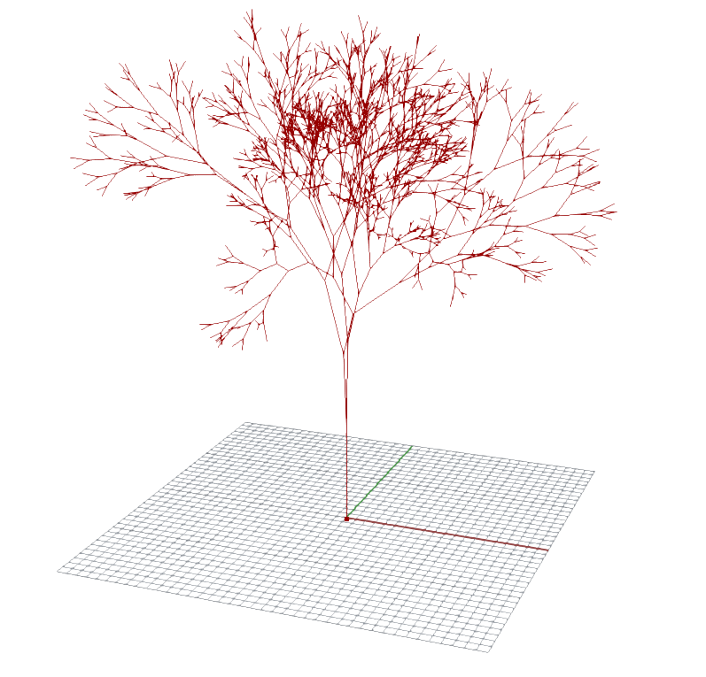
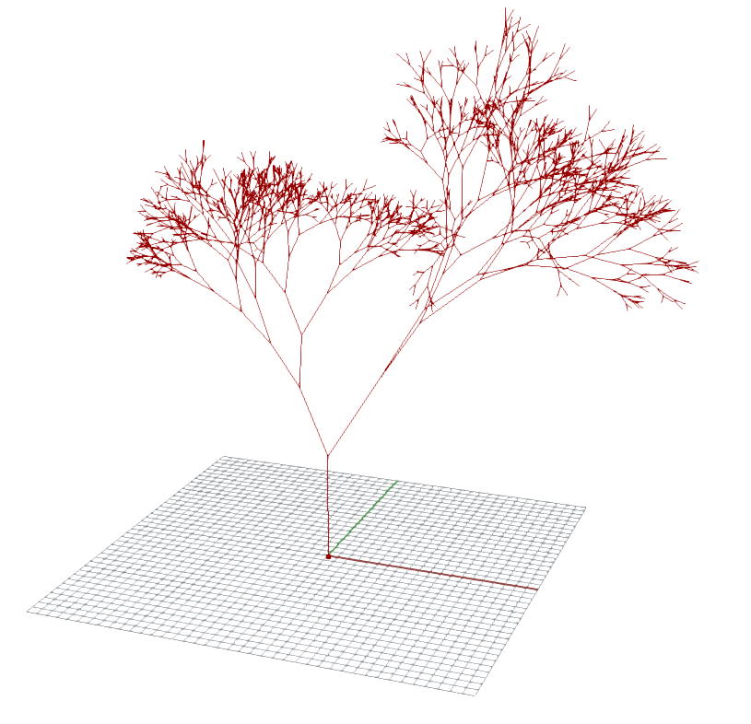
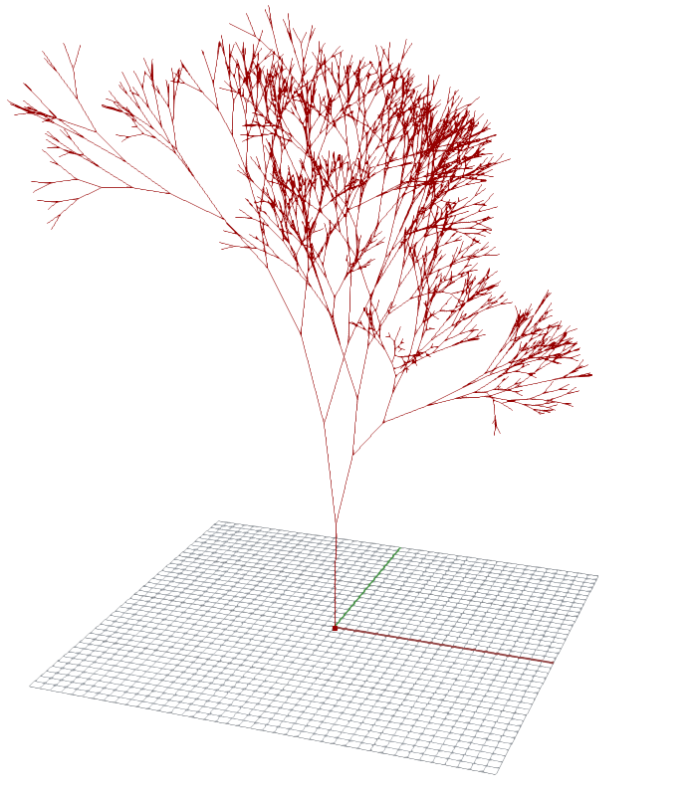
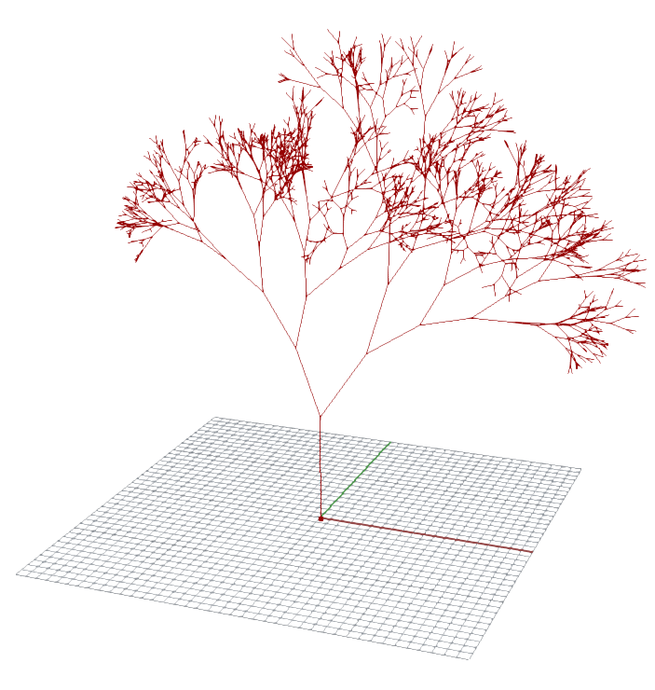
Live Example: Tree growth
Step 3: Adding random variations to the spread angle and shrink factor

Slide 31
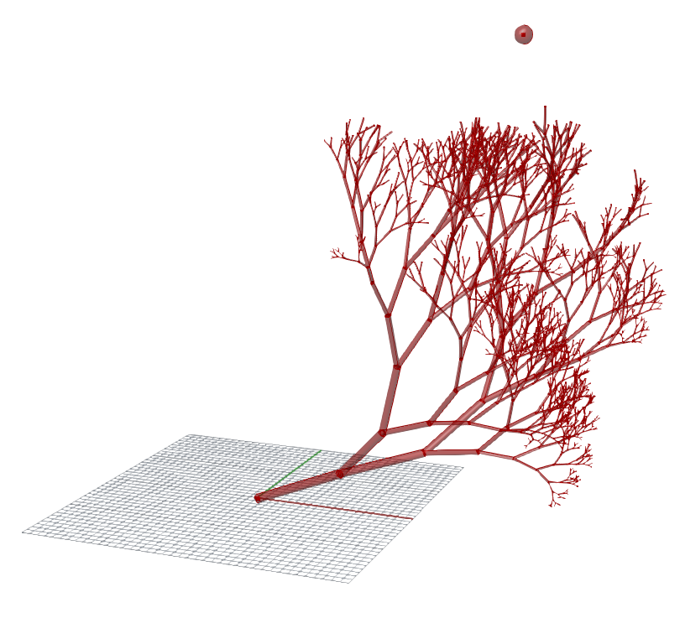
Tree growth: let the fun go on !
There are so many interesting features that you can add:
Attractor point that influence the direction of growth
Branches with thickness (that should also shrink like the branch length)
Attractor

Slide 32
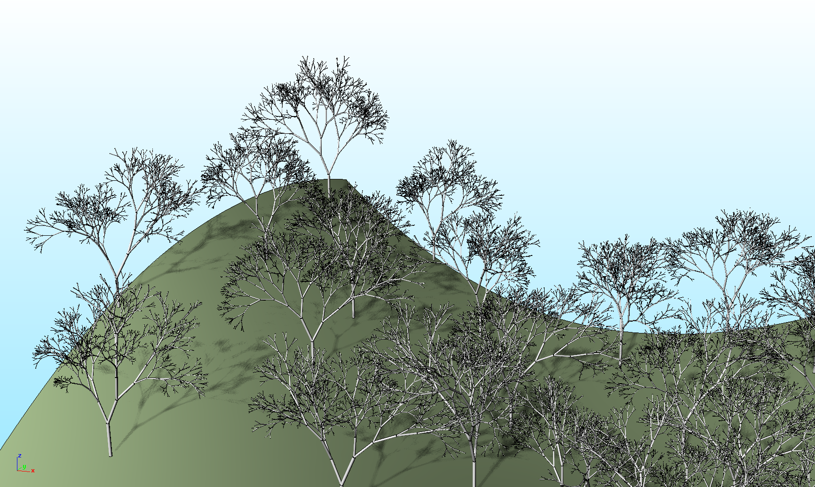
Tree growth: let the fun go on !
Make a little forest
Each tree will have a different look thanks to the random variations

